Slide 1
R Basics for Lecture 1
Econ B2000 Statistics and Introduction to Econometrics
Kevin R Foster, Colin Powell School, the City College of New York, CUNY

Slide 2
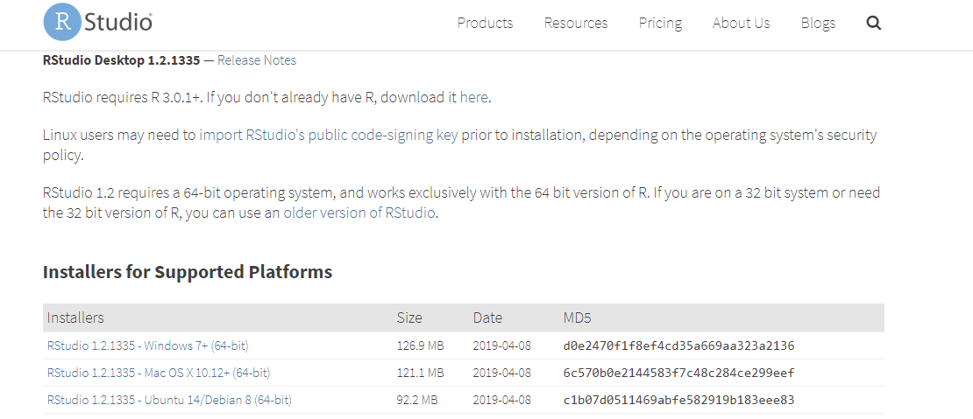
R as well as R Studio
https://www.rstudio.com/products/rstudio/download/#download
Notes:
R free to download, free to install & use, open source, often used (along w Python for data sci)
Get started, install in various methods for win/mac/linux (pause take some time to figure it out)
computer labs on campus have it too
open R Studio

Slide 3
Notes:
commands go in bottom left corner; copy-paste from Rmd
(eg - go to class page & download "markdown file for R Basics", save without the .txt and open in R-Studio)

Slide 4
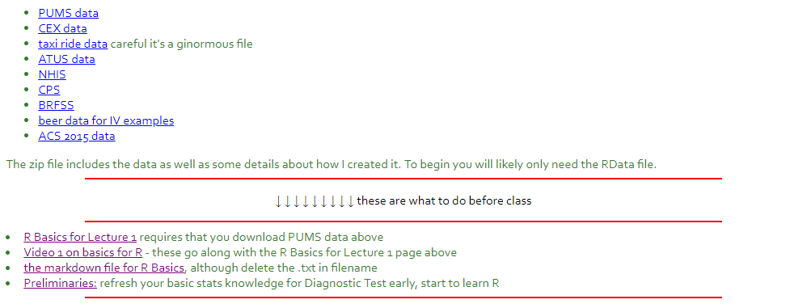
Class Page
http://kfoster.ccny.cuny.edu/classes/fall2019/
Notes:
go to class page to download data

Slide 5
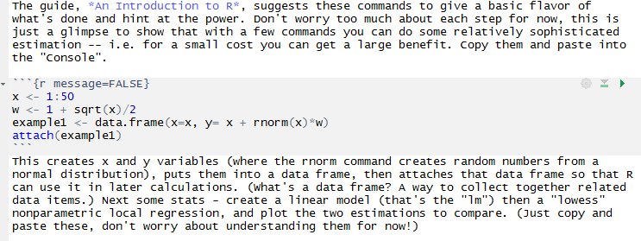
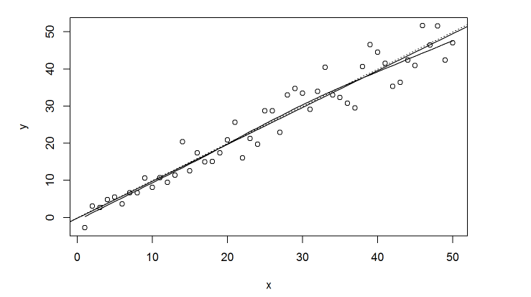
Notes:
Copy-paste from rmd file into console (alt, use CTRL-Enter)

Slide 6
Data for class
Begin by downloading the PUMS data
It’s zipped so unzip into a folder
Remember what folder you put it in…
getwd() in R-Studio
setwd() to change that
Or open file with mouse clicks and see the commands that generates
Notes:
zip file -- unzip! put into folder where R looks for it
note own OS might hide file extensions
dropdown menus that create code, alt ways
getwd()

Slide 7
Rmd files – R Markdown
Markdown files create both the text and data results. So rather than, with word-processing program, typing “the average value was” and then copy-pasting from your data analysis program, you can just use a single program such as R-Studio that integrates them.
That’s a bit more advanced so if you’re just starting off, postpone that for later
But if you’re moving along (and especially if this might become a career) then learn more
Notes:
Rmd files create readable files (web page, pdf, etc) along with data output

